Slide 1
Science and common sense in language acquisition
Stephen Matthews
University of Hong Kong

Slide 2
Outline
Common sense as unreliable in science
Linguistics as the science of language
Common sense is unreliable as a guide language: some examples
Is bilingualism good, bad or neutral for cognitive development?
Is language mixing good, bad or neutral for language/cognitive development?
Is it better to stick to a single language teacher or a range of teachers?

Slide 3
Science and common sense
Common sense: “sound practical judgment that is independent of specialized knowledge, training, or the like” (Dictionary.com)
In the natural sciences, the ‘common sense’ account is often incorrect
Galileo’s (thought) experiment:
- will the heavier ball fall faster than the small one?

Slide 4
Science and common sense
Why is common sense unreliable?
Cognitive biases underlie ‘common sense’ intuitions
Status quo bias
loss aversion
- optimistic bias

Slide 5
Science of language?
Linguistics: an invisible field
Definition: the scientific study of language (Lyons 1965)
Spectrum from natural science (neurolinguistics) to art (poetics)
Grammar writing: between art and science

Slide 6
Linguistics as science of language
Hypotheses are tested without prejudice.
Results are subject to peer review.
Results must be replicable.

Slide 7
Bilingualism and cognition
How does bilingualism impact on cognition and cognitive development? 3 possibilities:
1. negative effects
A source of confusion?
A burden which over-taxes children, especially those with learning difficulties?
2. positive effects
Richer, more diverse learning experiences?
Priming for further language learning?
3. neutral: cognitive development proceeds, perhaps on a genetically predetermined basis, regardless of the number of languages the child knows or learns

Slide 8
Cognitive advantages associated with bilingualism
Greater sensitivity to language
- metalinguistic awareness from age 2
Greater mental flexibility, creativity
Uses for empty boxes, bottles
Bilinguals outperform monolinguals in tasks that require them to ignore distracting information (Bialystok and Barac 2013)

Slide 9
Piaget’s sun-moon game
If we decided to call the sun “the moon” and the moon “the sun”, what would be in the sky when we go the bed at night? Would the sky be light or dark?
Bilingual children consistently score higher on such tasks
Separation of names from things
9

Slide 10
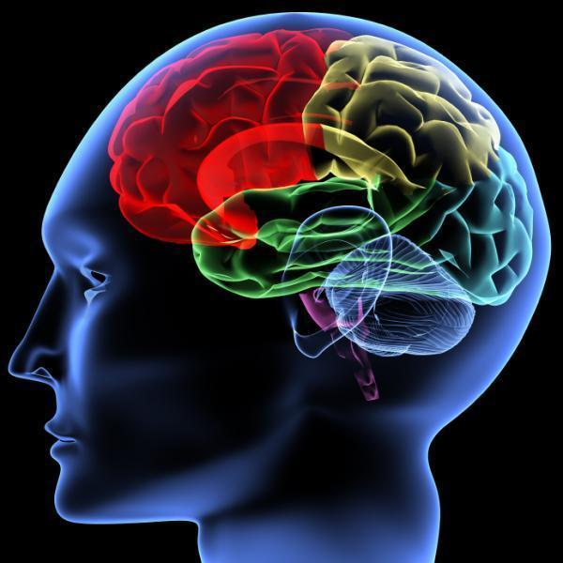
Cognitive advantages of early bilingualism
↑ creativity
↑ mental flexibility
↑ executive control: attention, selection, inhibition, monitoring
↑ ability to ignore distracting information and focus on objectives (Bialystok and Barac 2012)
Notes:
There’s an old debate about whether bilingualism is a curse or blessing. Bilingual advantage in executive functioning tasks reflects precocious development in only specific components of executive control.
In a recent issue of the Economist, our attention is drawn to the advantages of bilingualism. The article has a nice title ‘twice blessed’ referring to the blessings of bilingualism. Apart from the obvious advantage of being able to communicate with many more people, bilingual children have been shown to have an advantage in a range of cognitive tasks.
some aspects of the cognitive development of infants raised in a bilingual household must be undergoing acceleration in order to manage which of the two languages they are dealing with.”
The Economist Apr 16th 2009

Slide 11
Children with impairments
When a child suffers from an impairment such as Specific Language Impairment (SLI):
surely bilingualism will complicate the task?
based on this intuition, speech therapists have advised parents to help children by taking away one language
But controlled studies have shown that children exposed only to language X do not do any better on language X than children exposed to languages X and Y (Paradis et al 2005)
Withdrawing one of the languages does not help in the acquisition of the target language.
It also deprives children of the numerous advantages of bilingualism as discussed.

Slide 12
Aging and dementia
Mental exercise: do crossword puzzles delay dementia?
Learning a new language (or a new musical instrument) at any age results in new grey matter being formed.
Onset of dementia is delayed by about 4 years in bilinguals.
- discovered by Ellen Bialystok and colleagues in Canada
replicated by Thomas Bak and colleagues in Germany.
theory: bilingualism develops cognitive reserve

Slide 13
Code-mixing and mixed code teaching
Intuition/common sense: mixing languages must be bad
- Does mixing languages indicate confusion?
- Is mixed code teaching undesirable?

Slide 14
Code-mixing in bilingual children
All bilingual children mix their languages
ADULT: I nearly bump into you.
CHILD: lei5 bump into my fei4 tou5 laam5.
“You bump into my big belly.”
Children mix for good reasons, including lexical gaps and humour
Children's mixing is systematic and asymmetrical, not random
No evidence for confusion
Children pool their linguistic resources to express more complex content

Slide 15
Code-mixing in bilingual children
Measuring complexity of mixed utterances
Mean Length of Utterance (MLU);
Upper Bound: most complex utterance in a sample
Mixed utterances are more complex than single-language utterances

Slide 16
Kathryn’s MLU pattern

Slide 17
Code-mixing and mixed code teaching
Intuition/common sense: mixing languages must be bad
Is mixed code teaching undesirable?
1990s report recommended that mixed code teaching be avoided… without research basis!

Slide 18
Single vs multiple teachers
Is it better to have a single teacher for a language, or a variety of teachers?
A common sense answer: stick to one teacher at first

Slide 19
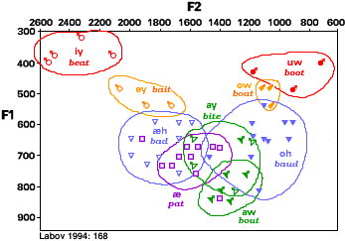
Single vs multiple teachers
Research by Patrick Wong of CUHK shows that students learn better when exposed to a range of speakers
Example: vowels are not fixed, but occupy overlapping areas within the vowel space
-> Pedagogical implication: alternate language teachers?

Slide 20
Conclusions
Common sense is unreliable with regard to language, as it is in physics
As the scientific study of language, linguistics offers some surprising answers to questions about language acquisition
- Growing understanding of bilingualism suggests lifelong cognitive advantages
- Children's language mixing is systematic and functional
- Language learning is more effective with input from multiple teachers

Slide 21
References
Bialystok, E & R. Barac. 2012. Emerging bilingualism: Dissociating advantages for metalinguistic awareness and executive control. Cognition 122:67–7.
Lyons, John. 1965. The Scientific Study of Language . Inaugural Lecture, University of Edinburgh.
Paradis, Johanne, Fred Genesee & Martha Crago. 2005. Dual Language Development and Disorders. Brookes Publishing.
Pearson, Barbara Zurer. 2008. Raising a Bilingual Child. Random House.

